Slide 1






INNOVA presents
MINI PROJECT

Slide 2





















IT AIMS TO CREATE AN
THE PROJECT WILL START IN JULY 2024
AND CONCLUDE BY NOVEMBER 2024.
THE PRIMARY GOALS ARE TO
INNOVATIVE ACTION-
MILESTONES INCLUDE COMPLETING THE
DELIVER AN ENGAGING GAME
ADVENTURE GAME DESIGNED TO
PROTOTYPE BY OCTOBERs
AND THE FINAL
CAPTIVATE GAMERS WITH ITS
GAME RELEASE IN NOVEMBER.
EXPERIENCE AND ACHIEVE A
UNIQUE STORYLINE AND
PLAYER SATISFACTION
IMMERSIVE GAMEPLAY.
RATING
"IN 'DESERT DINO DASHs' PLAYERS
GUIDE A DINOSAUR ON AN
ADVENTUROUS QUEST TO FIND FOOD
AND MAKE IT BACK HOME WHILE
REGULARLY UPDATE THE
SKILLFULLY NAVIGATING A PERILOUS
PROJECT STATUS TO REFLECT
LANDSCAPE FILLED WITH CACTI."
CURRENT PROGRESS.
THE SUCCESSFUL COMPLETION
OF THE PROJECT MARKS THE
THE FOCUS IS ON TAKING CORRECTIVE
CULMINATION OF OUR EFFORTS
ACTIONS TO ADDRESS ANY ISSUES OR
WITH ALL OBJECTIVES
DEVIATIONS FROM THE PROJECT PLAN.
ACHIEVED.

Slide 3
Planning:
Define the project scope, goals, and requirements. Develop a site map and establish the timeline and budget.
Design:
Create wireframes and visual mockups. Focus on user experience (UX) and interface design to outline the layout and look of the website.
Development:
WEB DEVELOPMENT
TheDailyDigest
Build the website using front-end (HTML, CSS, JavaScript) and back-end (server-side code, databases) technologies. Integrate content and functionality.
Testing:
Verify that the website works correctly by performing functional, compatibility, and performance tests. Fix any issues or bugs.
Launch:
Deploy the website to a live server. Monitor its performance, address any post-launch issues, and perform regular updates and maintenance.

Slide 4
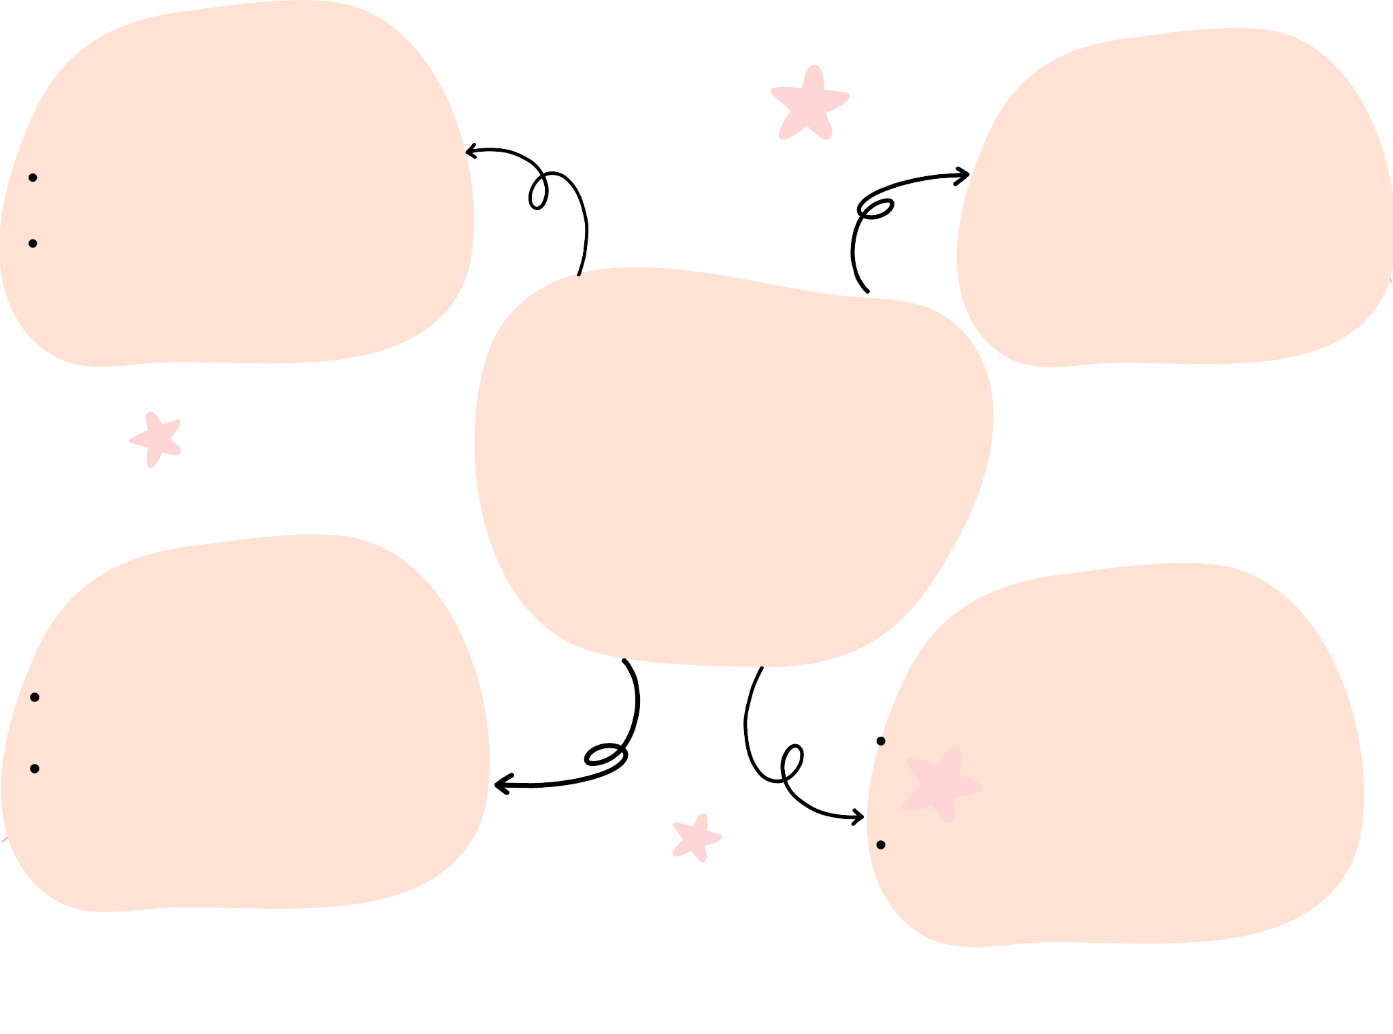
User Interface (UI)
Translate Button: A button to trigger the translation.
Output Field: A field to display the translated text.
Basic Development
Technologies: HTML, CSS, JavaScriptFlutter or React Native for cross- platform simplicity..
APP DEVELOPMENT
SpeakEasy
Deploy
Host on platforms like GitHub Pages or Netlify.
Use development tools to build and publish to app stores.
Maintenance
Add features like more languages or improvements based on feedback.
Check for any issues and fix bugs as needed.

Slide 5











OUR TEAM
Sagarika Srivastava(Leader) Sidra Shaikh
Bushra Ansari Sidra Solkar

Slide 6


THANK YOU !

